Slide 1
Industrial IoT Predictive Maintenance with Edge AI
CS4406-Core Course Project
1)Arjun V - 24CS0081
2)Hariharan C V – 24CS0288

Slide 2
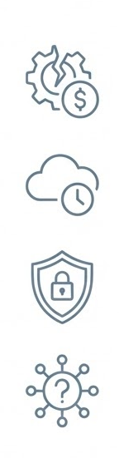
PROBLEM STATEMENT
Industrial equipment failures lead to sudden downtime and high costs for reparations.
Existing predictive systems depend on centralized cloud, causing latency & bottlenecks.
Data privacy & security risks arise when sharing sensitive operational data being used for monitoring.
Lack of real-time, adaptive, and secure predictive maintenance frameworks in Industrial IoT.

Slide 3
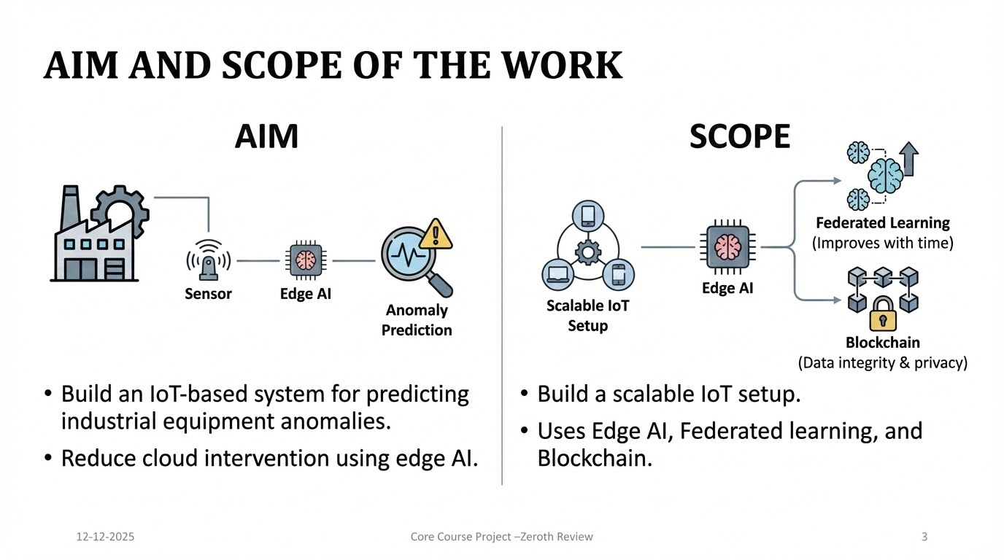
AIM AND SCOPE OF THE WORK
AIM:
The aim of the project is to build an IoT-based system that predicts anomaly for industrial equipments.
The project focusses to reduce cloud intervention by using edge AI.
SCOPE:
Build an IoT setup that is scalable, uses Edge AI, Federated learning to improve with time and Blockchain for data integrity and privacy.

Slide 4
ABSTRACT
In the domain of Industrial operations, industrial equipments plays a vital role for the industry. Such industrial equipments’ downtime and failures lead to significant financial loss and reduced productivity for the industry. The project “Predictive Maintenance” incorporates ML(Machine Learning), real-time monitoring, security to predict equipment malfunctions and anticipate equipment failures. Existing solutions for such limitations often depend on cloud infrastructure, which causes latency issues, bottlenecks when unstable network connections. This project falls on the domain of IIoT(Industrial Internet of Things) to address the existing issues by combining various technologies. The technologies that are planned to integrate in this project are Edge AI - To perform immediate processing of data near the data source, Blockchain-secured Federated Learning - allows training data locally on device data while preserving data security and enhance privacy. Digital Twin Technology - creates virtual replicas of the machinery to run a number of what-if scenarios. By combining such technologies, a software - hardware integrated system setup is obtained, which optimizes maintenance schedules and minimize equipments’ downtime by predictive maintenance.

Slide 5
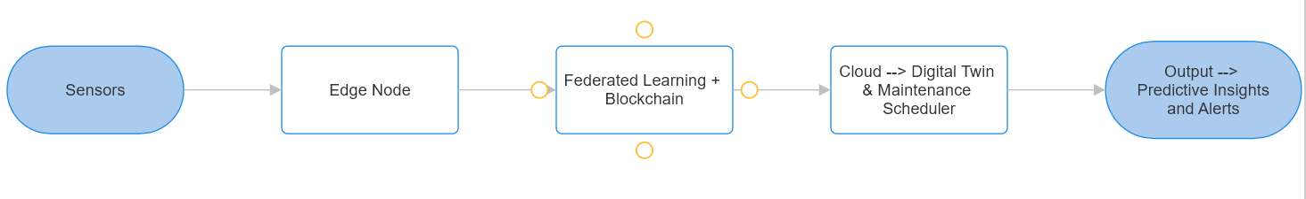
ARCHITECTURE DIAGRAM

Slide 6
HARDWARE / SOFTWARE
HARDWARE
ESP32
DHT22 – Temperature & humidity
MPU6050 – Vibration and motion
ACS712 – Current measurement
Motor & Motor driver
SOFTWARE
Arduino IDE
Python FastAPI – Backend API
MQTT – Real time communication protocol
TensorFlow – ML for anomaly detection
Flower framework – Federated Learning simulation
Ethereum – Blockchain-based model verification
React.js + Chart.js + Tailwind CSS - Realtime Dashboard
SQLite / MongoDB – Data storage and management

Slide 7
NOVELTY OF THE WORK
Edge-Based Anomaly Detection:
❖ In-edge fault detection in real-time, minimizing latency and cloud reliance.
Federated Learning with Blockchain Security :
❖ Preserves privacy (data remains local) and integrity via tamper-proof logging.
Digital Twin Integration :
❖ Replicas of virtual machines allow for proactive "what-if" simulations of failures.
Self-Optimizing Maintenance :
❖ Continuous learning enhances predictive accuracy over time

